Slide 1
Electricity and Magnetism
Ryan Cates
University of South Florida
Big Idea 11: Energy and Transfer and Transformation

Slide 2
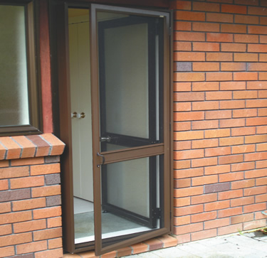
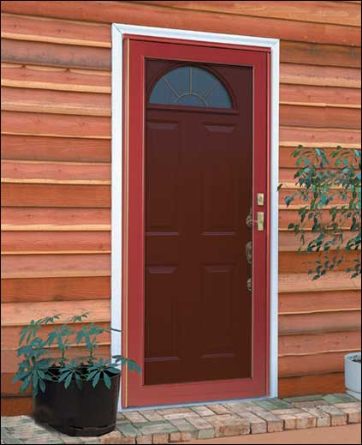
Basic Circuit Design
Conductivity?
  Conductors allow energy to pass through
  Insulators keep energy from passing through
Which is a better conductor of heat or wind?
Screen door
Solid metal door

Slide 3
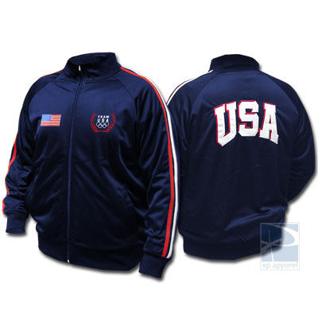
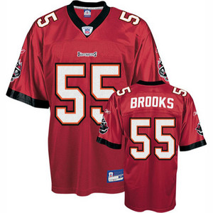
Which conducts more heat?
A USA Olympics jacket
Buccaneer's Jersey

Slide 4
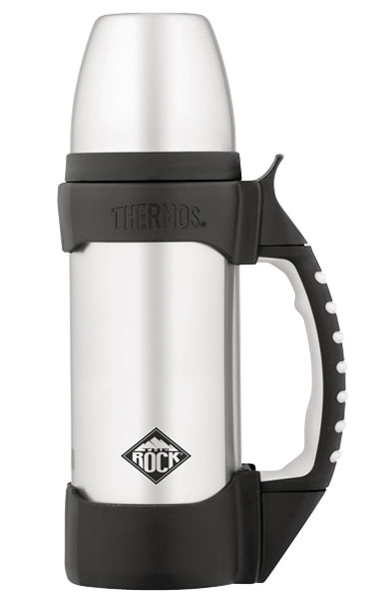
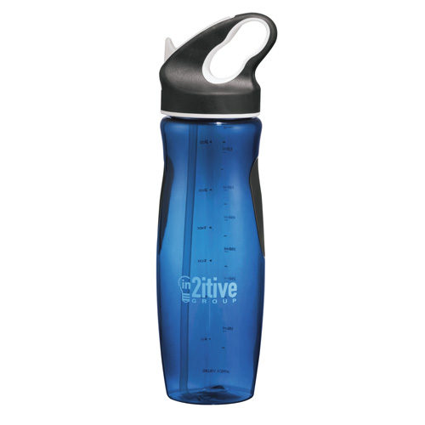
Which is a better insulator?
A Thermos?
A sports bottle?

Slide 5
Which is best at conducting electricity?
(These are demos)
Metal wire
Plastic
Wood
Metal Nails

Slide 6
Electricity and Circuits
Hila Science Video
"Science Video - Electricity, Series and Parallel." Hila. Web. 09 Oct. 2009. <http://hilaroad.com/video/electricity.html>.

Slide 7
Magnetism
What is Magnetism?
  An overall unequal alignment of charge creating positive and negative poles.

Slide 8
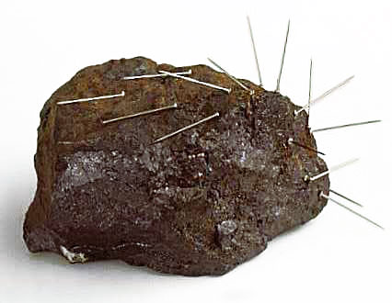
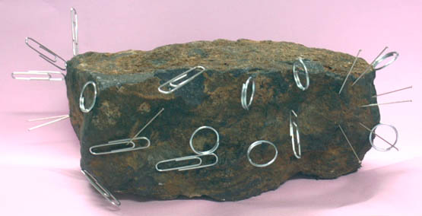
Magnets are found in nature
Magnetic rock has positive and negative poles just like bar magnets!

Slide 9
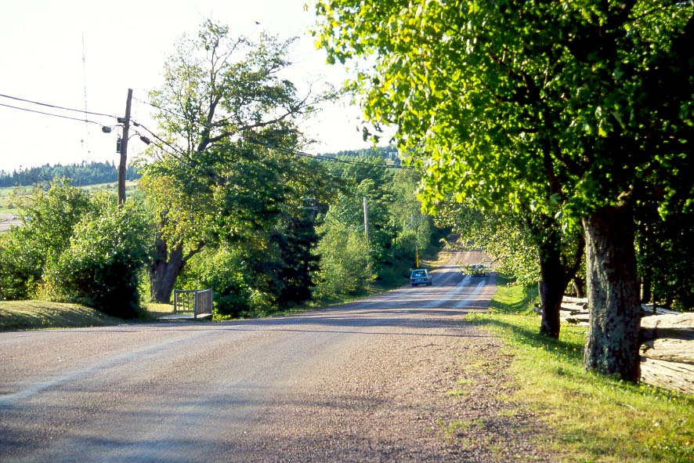
Magnetic Hill, Canada

Slide 10
References
http://media.photobucket.com/image/dipole%20moment%20water/Translator_bucket/Water/molecu4.gif
http://www.buylodestones.com/retail/bigkit1.jpg
http://www.huntsvilleglass.com/images/sugarcreek/vallisredstormdoor.jpg
http://www.homeplus.co.nz/products/security/images/6/2.jpg
http://stores.xpapparel.com/images/OL-4445-USA.jpg
http://di1.shopping.com/images1/pi/d5/40/54/47915801-300x300-0-0_Brooks+Derrick+Brooks+55+Tampa+Bay+Buccaneers+Yout.jpg
http://www.productwiki.com/upload/images/thermos_the_rock.jpg

